Slide 1
CS 1674: Intro to Computer Vision Visual Recognition
Prof. Adriana Kovashka University of Pittsburgh
October 22, 2019

Slide 2
Plan for this lecture
What is recognition?
a.k.a. classification, categorization
Support vector machines
Separable case / non-separable case
Linear / non-linear (kernels)
The importance of generalization
The bias-variance trade-off (applies to all classifiers)
Example approach for scene classification

Slide 3
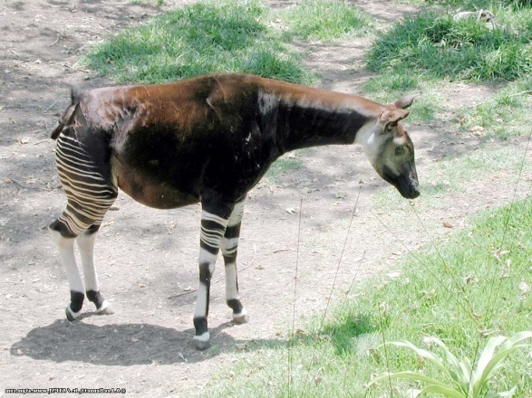
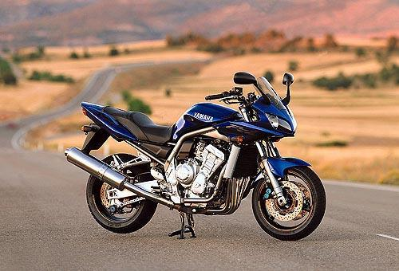
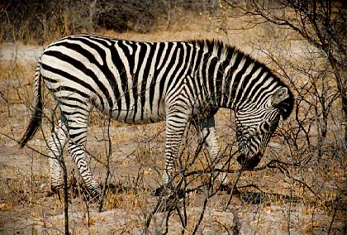
Classification
Given a feature representation for images, how do we learn a model for distinguishing features from different classes?
Decision boundary
Zebra
Non-zebra
Slide credit: L. Lazebnik

Slide 4
Classification
Assign input vector to one of two or more classes
Input space divided into decision regions separated by decision boundaries
Slide credit: L. Lazebnik

Slide 5
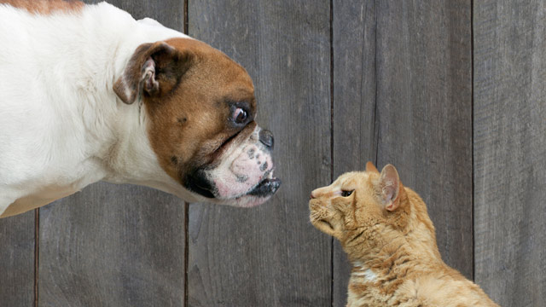
Examples of image classification
Two-class (binary): Cat vs Dog
Adapted from D. Hoiem

Slide 6
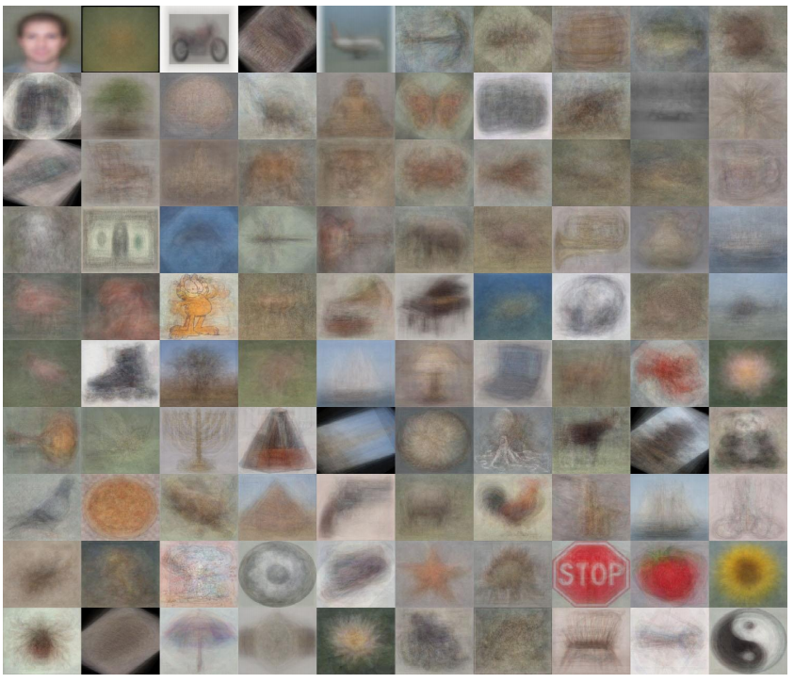
Examples of image classification
Multi-class (often): Object recognition
Caltech 101 Average Object Images
Adapted from D. Hoiem

Slide 7
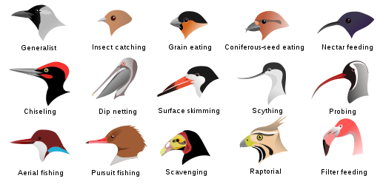
Examples of image classification
Fine-grained recognition
Visipedia Project
Slide credit: D. Hoiem

Slide 8
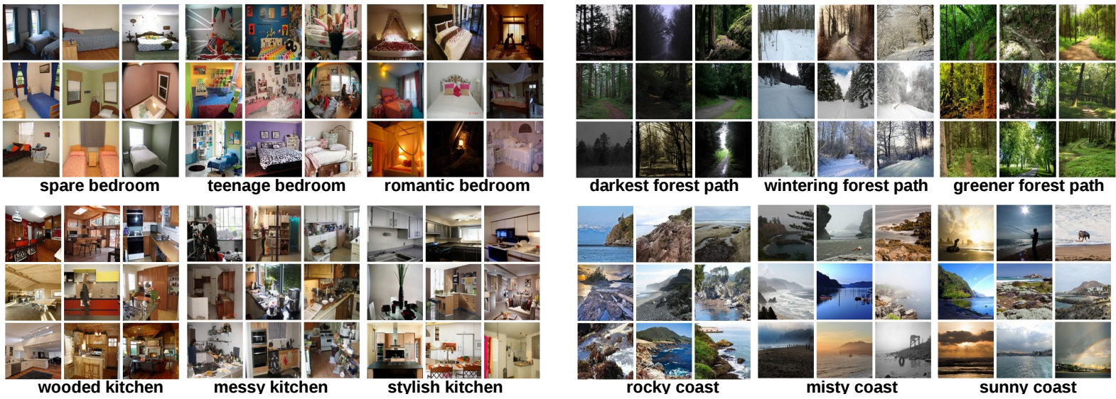
Examples of image classification
Place recognition
Places Database [Zhou et al. NIPS 2014]
Slide credit: D. Hoiem

Slide 9
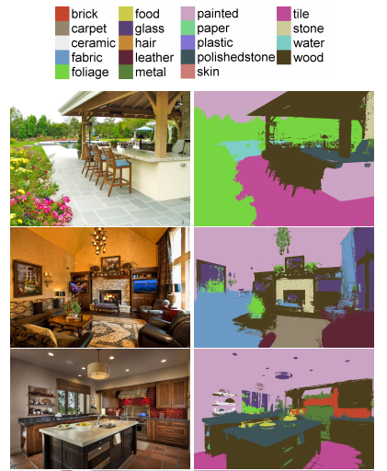

Examples of image classification
Material recognition
[Bell et al. CVPR 2015]
Slide credit: D. Hoiem

Slide 10
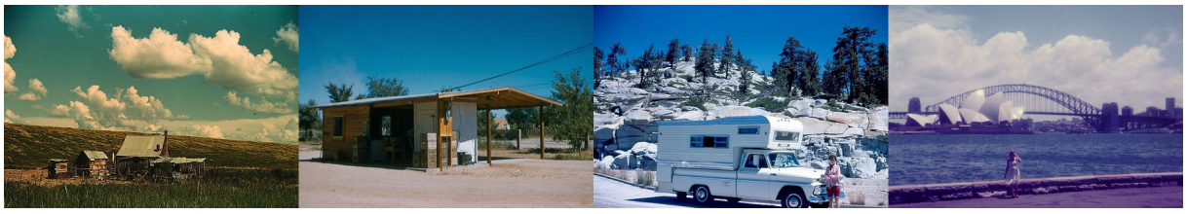
Examples of image classification
Dating historical photos
1940
1953
1966
1977
[Palermo et al. ECCV 2012]
Slide credit: D. Hoiem

Slide 11
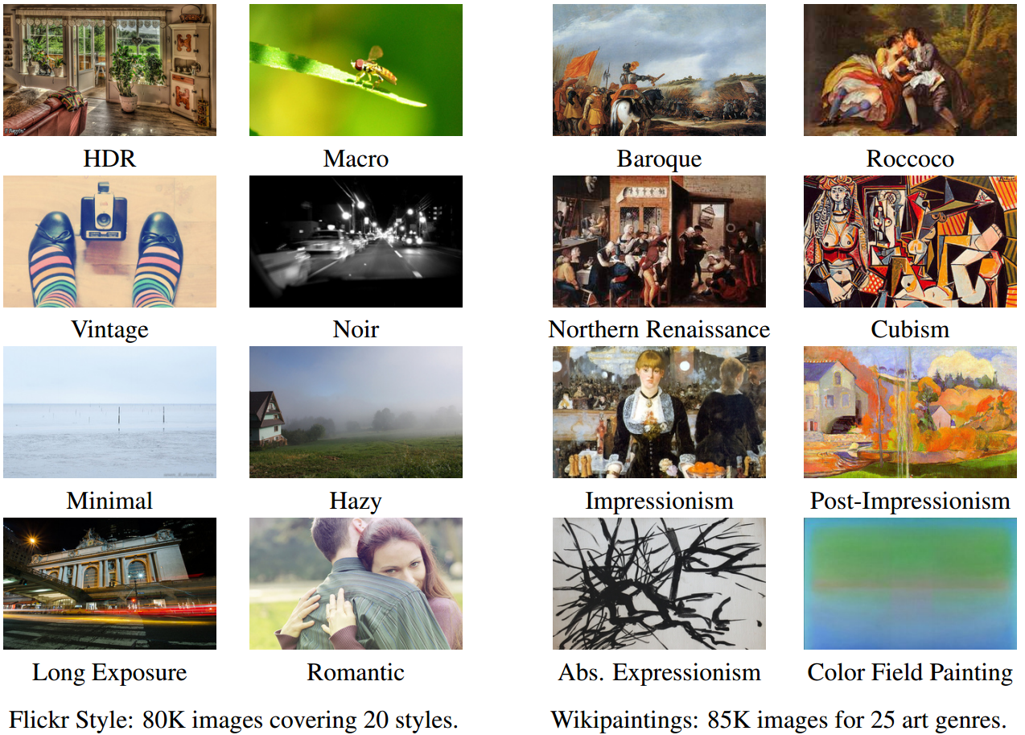
Examples of image classification
Image style recognition
[Karayev et al. BMVC 2014]
Slide credit: D. Hoiem

Slide 12

Recognition: A machine learning approach

Slide 13
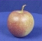
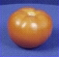
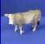
The machine learning framework
Apply a prediction function to a feature representation of the image to get the desired output:
f( ) = “apple”
f( ) = “tomato”
f( ) = “cow”
Slide credit: L. Lazebnik

Slide 14
The machine learning framework
y = f(x)
Training: given a training set of labeled examples {(x₁,y₁), …, (x_{N},y_{N})}, estimate the prediction function f by minimizing the prediction error on the training set
Evaluate multiple hypotheses f₁, f₂, f_{H} … and pick the best one as f
Testing: apply f to a never before seen test example x and output the predicted value y = f(x)
output
prediction function
image / image feature
Slide credit: L. Lazebnik

Slide 15
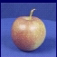
The old-school way
Training
Training Labels
Training Images
Image Features
Training
Learned model
Testing
Image Features
Learned model
Prediction
Test Image
Slide credit: D. Hoiem and L. Lazebnik

Slide 16
The simplest classifier
Test example
Training examples from class 2
Training examples from class 1
f(x) = label of the training example nearest to x
All we need is a distance function for our inputs
No training required!
Slide credit: L. Lazebnik

Slide 17
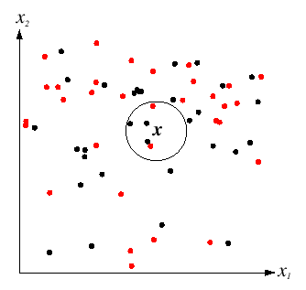
K-Nearest Neighbors classification
For a new point, find the k closest points from training data
Labels of the k points “vote” to classify
k = 5
Black = negative
Red = positive
If query lands here, the 5 NN consist of 3 negatives and 2 positives, so we classify it as negative.
Slide credit: D. Lowe

Slide 18
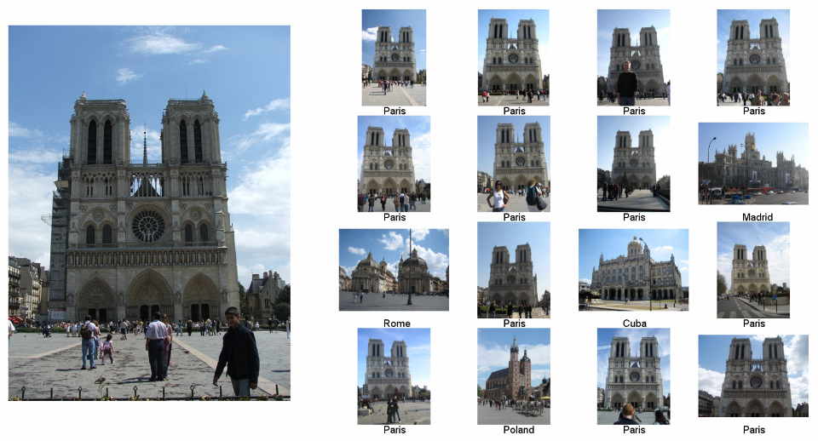
im2gps: Estimating Geographic Information from a Single Image James Hays and Alexei Efros, CVPR 2008
Where was this image taken?
Nearest Neighbors according to bag of SIFT + color histogram + a few others
Slide credit: James Hays

Slide 19
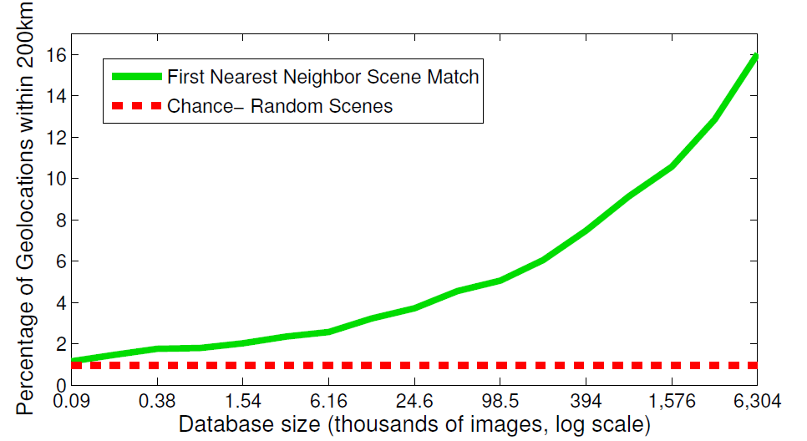
The Importance of Data
Slides: James Hays

Slide 20
Linear classifier
Find a linear function to separate the classes
f(x) = sgn(w₁x₁ + w₂x₂ + … + w_{D}x_{D}) = sgn(w ⋅ x)
Slide credit: L. Lazebnik

Slide 21
Linear classifier
Decision = sign(w^{T}x) = sign(w1*x1 + w2*x2)
x2
x1
(0, 0)
What should the weights be?

Slide 22
Lines in R²
Let
Kristen Grauman

Slide 23
Lines in R²
Let
Kristen Grauman

Slide 24
Lines in R²
Let
Kristen Grauman

Slide 25
Lines in R²
Let
distance from point to line
Kristen Grauman

Slide 26
Lines in R²
Let
distance from point to line
Kristen Grauman

Slide 27
Linear classifiers
Find linear function to separate positive and negative examples
B
C
A
D
Which line is best?
C. Burges, A Tutorial on Support Vector Machines for Pattern Recognition, Data Mining and Knowledge Discovery, 1998

Slide 28
Support vector machines
Discriminative classifier based on optimal separating line (for 2d case)
Maximize the margin between the positive and negative training examples
C. Burges, A Tutorial on Support Vector Machines for Pattern Recognition, Data Mining and Knowledge Discovery, 1998

Slide 29
Support vector machines
Want line that maximizes the margin.
wx+b=1
wx+b=0
wx+b=-1
For support, vectors,
Support vectors
Margin
C. Burges, A Tutorial on Support Vector Machines for Pattern Recognition, Data Mining and Knowledge Discovery, 1998

Slide 30
Support vector machines
Want line that maximizes the margin.
wx+b=1
wx+b=0
wx+b=-1
For support, vectors,
Distance between point and line:
For support vectors:
Support vectors
Margin
C. Burges, A Tutorial on Support Vector Machines for Pattern Recognition, Data Mining and Knowledge Discovery, 1998

Slide 31
Support vector machines
Want line that maximizes the margin.
wx+b=1
wx+b=0
wx+b=-1
For support, vectors,
Distance between point and line:
Therefore, the margin is 2 / ||w||
Support vectors
Margin
C. Burges, A Tutorial on Support Vector Machines for Pattern Recognition, Data Mining and Knowledge Discovery, 1998

Slide 32
Finding the maximum margin line
Maximize margin 2/||w||
Correctly classify all training data points:
Quadratic optimization problem:
Minimize Subject to y_{i}(w·x_{i}+b) ≥ 1
One constraint for each training point.
Note sign trick.
C. Burges, A Tutorial on Support Vector Machines for Pattern Recognition, Data Mining and Knowledge Discovery, 1998

Slide 33
Finding the maximum margin line
Solution:
Learned weight
Support vector
C. Burges, A Tutorial on Support Vector Machines for Pattern Recognition, Data Mining and Knowledge Discovery, 1998

Slide 34
Finding the maximum margin line
Solution: b = y_{i} – w·x_{i} (for any support vector)
Classification function:
Notice that it relies on an inner product between the test point x and the support vectors x_{i}
(Solving the optimization problem also involves computing the inner products x_{i} · x_{j} between all pairs of training points)
If f(x) < 0, classify as negative, otherwise classify as positive.
C. Burges, A Tutorial on Support Vector Machines for Pattern Recognition, Data Mining and Knowledge Discovery, 1998

Slide 35
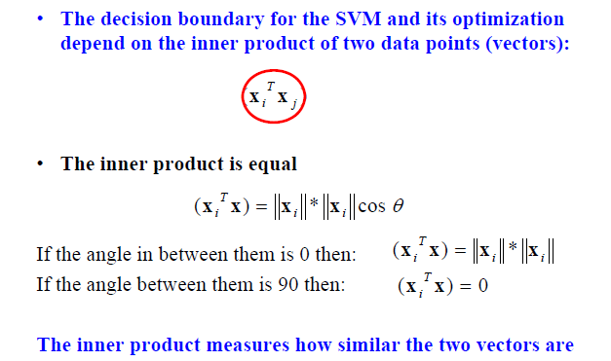
Inner product
Adapted from Milos Hauskrecht

Slide 36
Nonlinear SVMs
Datasets that are linearly separable work out great:
But what if the dataset is just too hard?
We can map it to a higher-dimensional space:
0
x
0
x
x²
0
x
Andrew Moore

Slide 37
Nonlinear SVMs
General idea: the original input space can always be mapped to some higher-dimensional feature space where the training set is separable:
Φ: x → φ(x)
Andrew Moore

Slide 38
Nonlinear kernel: Example
Consider the mapping
x²
Svetlana Lazebnik

Slide 39
The “Kernel Trick”
The linear classifier relies on dot product between vectors K(x_{i} , x_{j}) = x_{i} · x_{j}
If every data point is mapped into high-dimensional space via some transformation Φ: x_{i} → φ(x_{i} ), the dot product becomes: K(x_{i} , x_{j}) = φ(x_{i} ) · φ(x_{j})
A kernel function is similarity function that corresponds to an inner product in some expanded feature space
The kernel trick: instead of explicitly computing the lifting transformation φ(x), define a kernel function K such that: K(x_{i} , x_{j}) = φ(x_{i} ) · φ(x_{j})
Andrew Moore

Slide 40
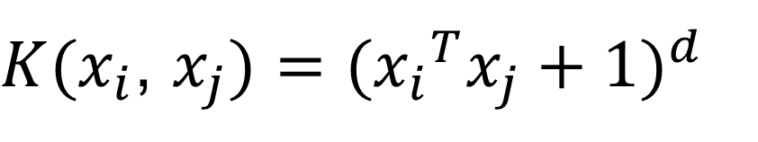
Examples of kernel functions
Linear:
Polynomials of degree up to d:
Gaussian RBF:
Histogram intersection:
$K(x_{i}$, $x_{j})={({x_{i}}^{T}x_{j}+1)}^{d}$
Andrew Moore / Carlos Guestrin

Slide 41
The benefit of the “kernel trick”
Example: Polynomial kernel for 2-dim features
… lives in 6 dimensions
With the kernel trick, we directly compute an inner product in 2-dim space, obtaining a scalar that we add 1 to and exponentiate

Slide 42
Hard-margin SVMs
The w that minimizes…
Maximize margin

Slide 43
Soft-margin SVMs
# data samples
Misclassification
cost
Slack variable
The w that minimizes…
Maximize margin
Minimize misclassification

Slide 44
What about multi-class SVMs?
Unfortunately, there is no “definitive” multi-class SVM formulation
In practice, we have to obtain a multi-class SVM by combining multiple two-class SVMs
One vs. others
Training: learn an SVM for each class vs. the others
Testing: apply each SVM to the test example, and assign it to the class of the SVM that returns the highest decision value
One vs. one
Training: learn an SVM for each pair of classes
Testing: each learned SVM “votes” for a class to assign to the test example
Svetlana Lazebnik

Slide 45
Multi-class problems
One-vs-all (a.k.a. one-vs-others)
Train K classifiers
In each, pos = data from class i, neg = data from classes other than i
The class with the most confident prediction wins
Example:
You have 4 classes, train 4 classifiers
1 vs others: score 3.5
2 vs others: score 6.2
3 vs others: score 1.4
4 vs other: score 5.5
Final prediction: class 2

Slide 46
Multi-class problems
One-vs-one (a.k.a. all-vs-all)
Train K(K-1)/2 binary classifiers (all pairs of classes)
They all vote for the label
Example:
You have 4 classes, then train 6 classifiers
1 vs 2, 1 vs 3, 1 vs 4, 2 vs 3, 2 vs 4, 3 vs 4
Votes: 1, 1, 4, 2, 4, 4
Final prediction is class 4

Slide 47
Using SVMs
Select a kernel function.
Compute pairwise kernel values between labeled examples.
Use this “kernel matrix” to solve for SVM support vectors & alpha weights.
To classify a new example: compute kernel values between new input and support vectors, apply alpha weights, check sign of output.
Adapted from Kristen Grauman

Slide 48
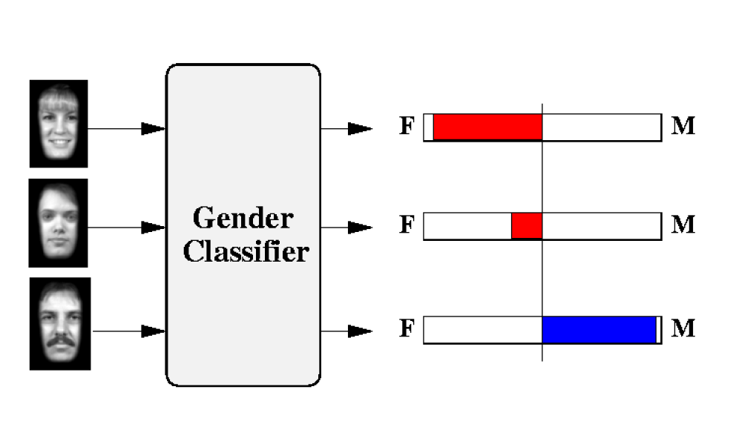
Example: Learning gender w/ SVMs
Moghaddam and Yang, Learning Gender with Support Faces, TPAMI 2002
Moghaddam and Yang, Face & Gesture 2000
Kristen Grauman

Slide 49
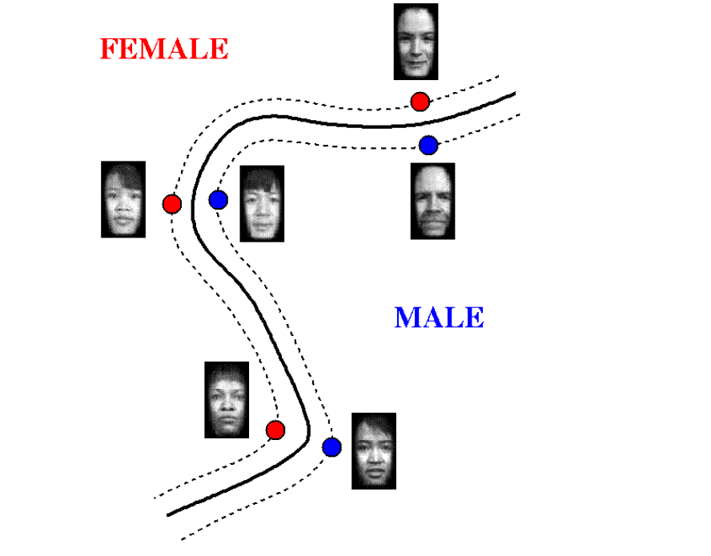
Example: Learning gender w/ SVMs
Support faces
Kristen Grauman

Slide 50
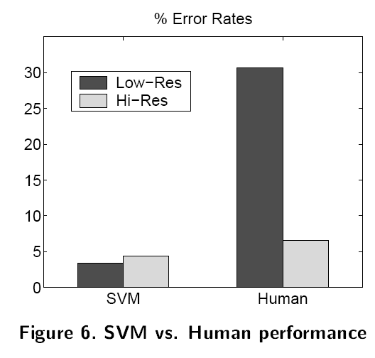
Example: Learning gender w/ SVMs
SVMs performed better than humans, at either resolution
Kristen Grauman

Slide 51
Some SVM packages
LIBSVM http://www.csie.ntu.edu.tw/~cjlin/libsvm/
LIBLINEAR https://www.csie.ntu.edu.tw/~cjlin/liblinear/
SVM Light http://svmlight.joachims.org/

Slide 52
Linear classifiers vs nearest neighbors
Linear pros:
Low-dimensional parametric representation
Very fast at test time
Linear cons:
Can be tricky to select best kernel function for a problem
Learning can take a very long time for large-scale problem
NN pros:
Works for any number of classes
Decision boundaries not necessarily linear
Nonparametric method
Simple to implement
NN cons:
Slow at test time (large search problem to find neighbors)
Storage of data
Especially need good distance function (but true for all classifiers)
Adapted from L. Lazebnik

Slide 53
Training vs Testing
What do we want?
High accuracy on training data?
No, high accuracy on unseen/new/test data!
Why is this tricky?
Training data
Features (x) and labels (y) used to learn mapping f
Test data
Features (x) used to make a prediction
Labels (y) only used to see how well we’ve learned f!!!
Validation data
Held-out set of the training data
Can use both features (x) and labels (y) to tune parameters of the model we’re learning

Slide 54

Generalization
Training set (labels known)
Test set (labels unknown)
How well does a learned model generalize from the data it was trained on to a new test set?
Slide credit: L. Lazebnik

Slide 55
Generalization
Components of generalization error
Noise in our observations: unavoidable
Bias: due to inaccurate assumptions/simplifications made by the model
Variance: models estimated from different training sets differ greatly rom each other
Underfitting: model is too “simple” to represent all the relevant class characteristics
High bias and low variance
High training error and high test error
Overfitting: model is too “complex” and fits irrelevant characteristics (noise) in the data
Low bias and high variance
Low training error and high test error
Slide credit: L. Lazebnik

Slide 56
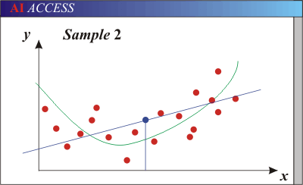
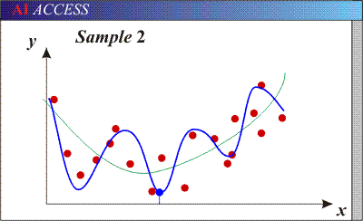
Generalization
Models with too few parameters are inaccurate because of a large bias (not enough flexibility).
Models with too many parameters are inaccurate because of a large variance (too much sensitivity to the sample).
Purple dots = possible test points
Red dots = training data (all that we see before we ship off our model!)
Green curve = true underlying model Blue curve = our predicted model/fit
Adapted from D. Hoiem

Slide 57
Training vs test error
Underfitting
Overfitting
Error
Test error
Training error
High Bias
Low Variance
Complexity
Low Bias
High Variance
Slide credit: D. Hoiem

Slide 58
The effect of training set size
Few training examples
Test Error
Many training examples
High Bias
Low Variance
Complexity
Low Bias
High Variance
Slide credit: D. Hoiem
Notes:
Note: these figures don’t work in pdf

Slide 59
Choosing the trade-off between bias and variance
Need validation set (separate from the test set)
Apply this model to test set
Validation error
Error
Training error
High Bias
Low Variance
Complexity
Low Bias
High Variance
Slide credit: D. Hoiem

Slide 60
Generalization tips
Try simple classifiers first
Better to have smart features and simple classifiers than simple features and smart classifiers
Use increasingly powerful classifiers with more training data
As an additional technique for reducing variance, try regularizing the parameters (penalize high magnitude weights)
Slide credit: D. Hoiem
Notes:
You can only get generalization through assumptions.

Slide 61

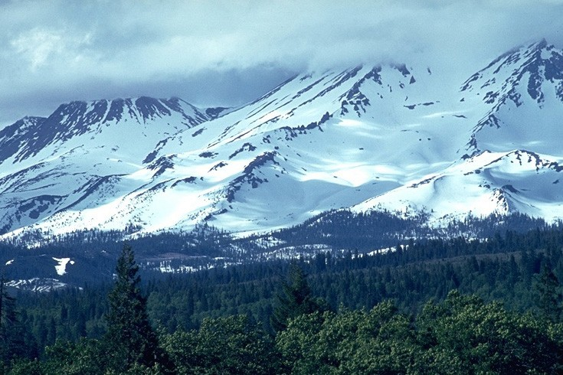
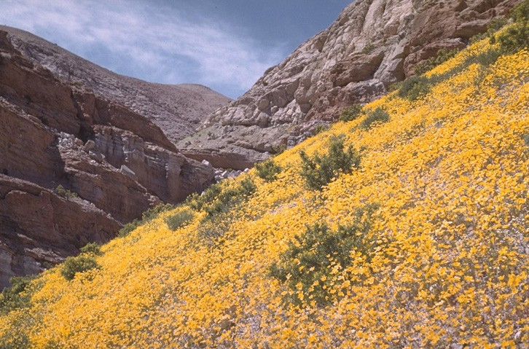
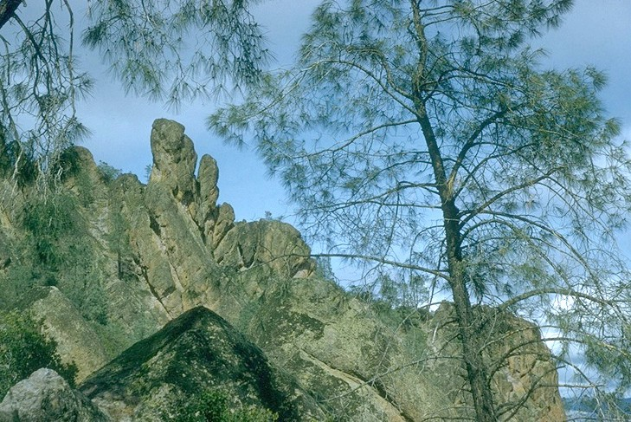
Beyond Bags of Features: Spatial Pyramid Matching for Recognizing Natural Scene Categories
Winner of 2016 Longuet-Higgins Prize
CVPR 2006
Svetlana Lazebnik (slazebni@uiuc.edu)
Beckman Institute, University of Illinois at Urbana-Champaign
Cordelia Schmid (cordelia.schmid@inrialpes.fr)
INRIA Rhône-Alpes, France
Jean Ponce (ponce@di.ens.fr)
Ecole Normale Supérieure, France

Slide 62
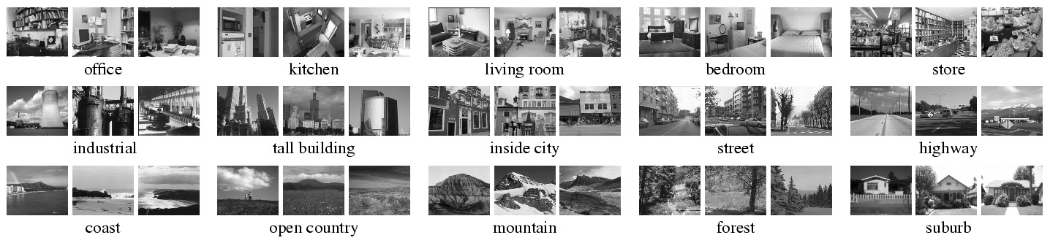
Scene category dataset
Fei-Fei & Perona (2005), Oliva & Torralba (2001)
http://www-cvr.ai.uiuc.edu/ponce_grp/data
Slide credit: L. Lazebnik

Slide 63
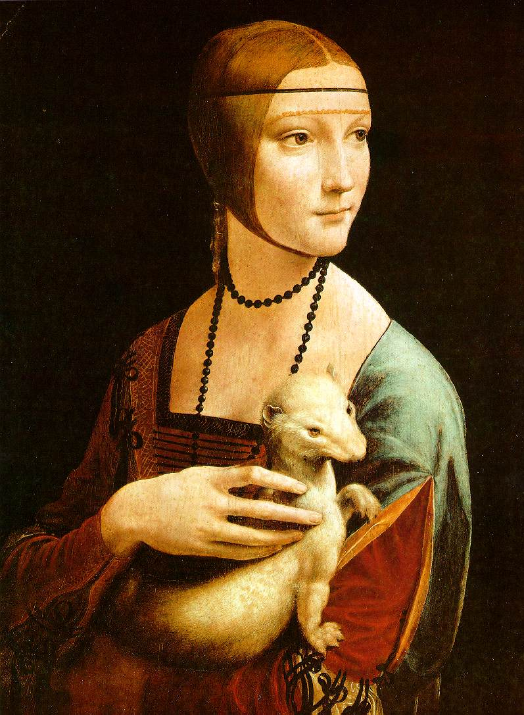
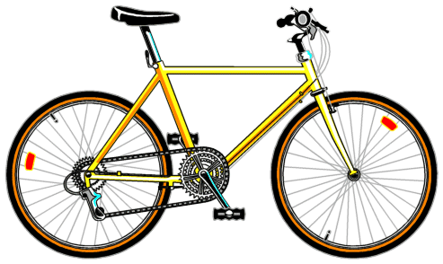
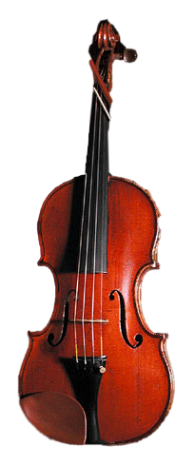
Bag-of-words representation
Extract local features
Learn “visual vocabulary” using clustering
Quantize local features using visual vocabulary
Represent images by frequencies of “visual words”
Slide credit: L. Lazebnik

Slide 64
Image categorization with bag of words
Training
Compute bag-of-words representation for training images
Train classifier on labeled examples using histogram values as features
Labels are the scene types (e.g. mountain vs field)
Testing
Extract keypoints/descriptors for test images
Quantize into visual words using the clusters computed at training time
Compute visual word histogram for test images
Compute labels on test images using classifier obtained at training time
Evaluation only, do only once: Measure accuracy of test predictions by comparing them to ground-truth test labels (obtained from humans)
Adapted from D. Hoiem

Slide 65

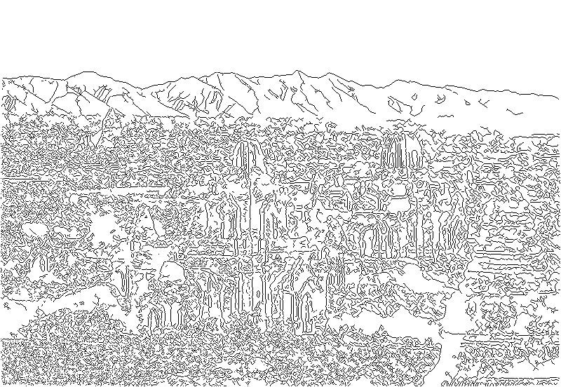
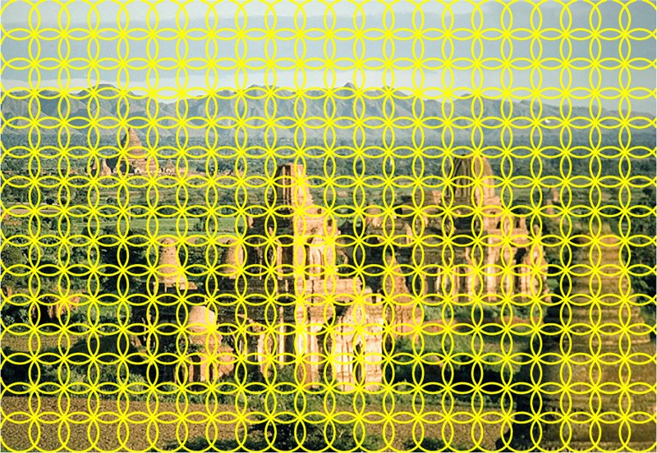
Feature extraction (on which BOW is based)
Weak features
Strong features
Edge points at 2 scales and 8 orientations (vocabulary size 16)
SIFT descriptors of 16x16 patches sampled on a regular grid, quantized to form visual vocabulary (size 200, 400)
Slide credit: L. Lazebnik

Slide 66
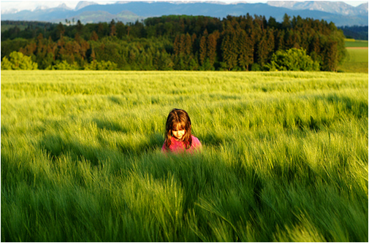
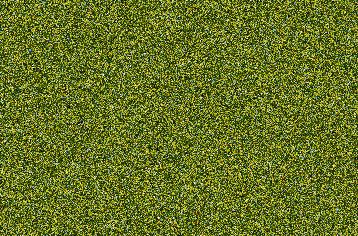
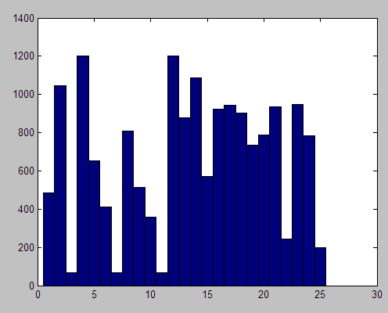
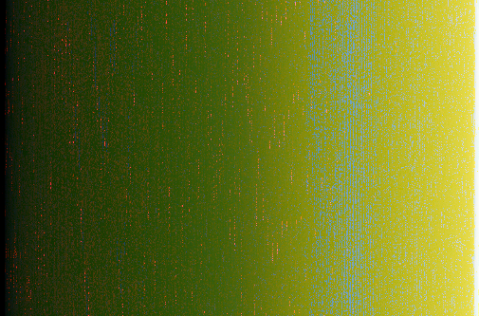
What about spatial layout?
All of these images have the same color histogram
Slide credit: D. Hoiem
Notes:
So far, global histogram over the whole image discard spatial information
Images contain structures and looking at a scene spatial distribution of feature we want to capture but we throw them away
Result in the fact that I can construct a very different image and still get the same histogram
This image is obvious a scene on grassland but with the noisy and gradient image on the bottom, color histogram

Slide 67
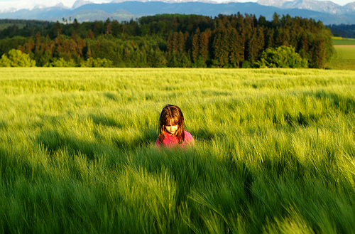
Spatial pyramid
Compute histogram in each spatial bin
Slide credit: D. Hoiem
Notes:
Overcome this, global, pyramid of histogram
Split into spatial bins at several levels and compute the histogram in each of them

Slide 68
Spatial pyramid
[Lazebnik et al. CVPR 2006]
Slide credit: D. Hoiem
Notes:
In more details, we still have the global histogram, but then I also have histograms computed in this 2x2 grid and histogram computed in 4x4 grid
Each of the histograms are individual normalized. They are weighted because you want each level to have equal weights, and combined together.
This spatial pyramid bag of bow is often considered as the goto feature to image categorization, works best for scenes, also works for most object.
One critism high dimensionality and you can deal with by doing PCA dimension reduction

Slide 69
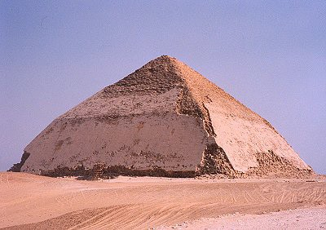
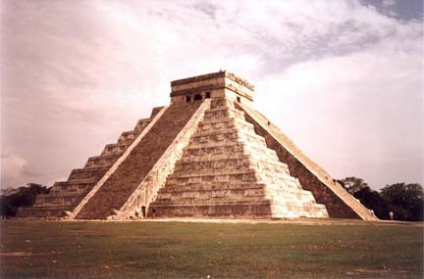
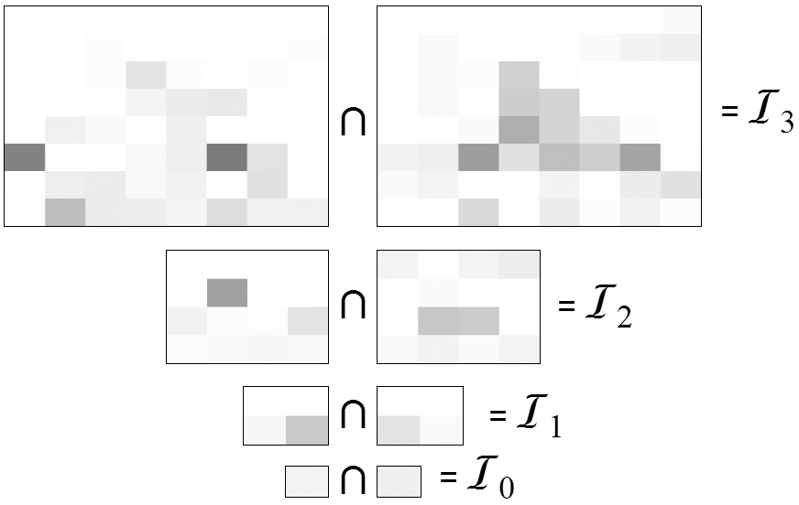
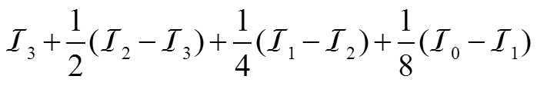
Pyramid matching
Indyk & Thaper (2003), Grauman & Darrell (2005)
Matching using pyramid and histogram intersection for some particular visual word:
x_{i}
x_{j}
Original images
Feature histograms: Level 3
Level 2
Level 1
Level 0
Total weight (value of pyramid match kernel):
K( x_{i} , x_{j} )
Adapted from L. Lazebnik

Slide 70
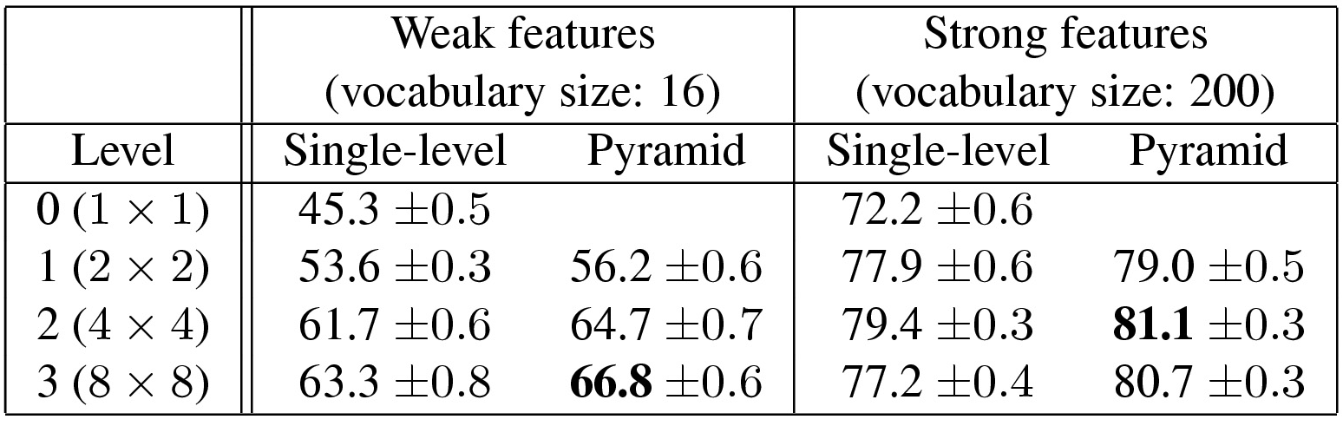
Scene category dataset
Fei-Fei & Perona (2005), Oliva & Torralba (2001)
http://www-cvr.ai.uiuc.edu/ponce_grp/data
Multi-class classification results (100 training images per class)
Fei-Fei & Perona: 65.2%
Slide credit: L. Lazebnik

Slide 71
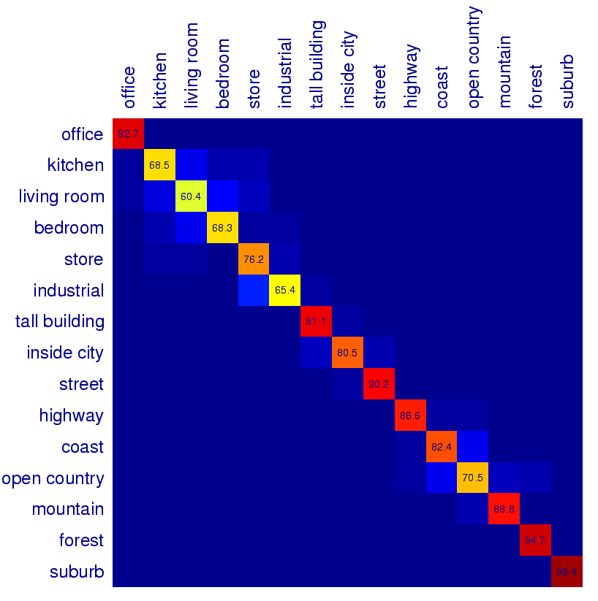
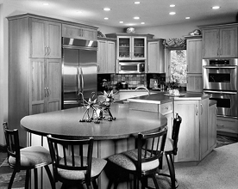
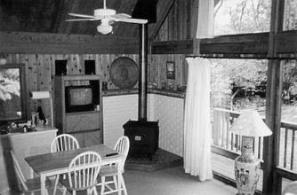
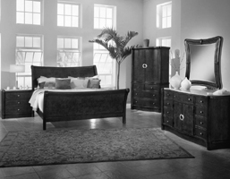
Scene category confusions
Difficult indoor images
kitchen
living room
bedroom
Slide credit: L. Lazebnik

Slide 72
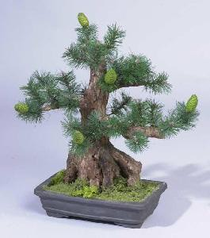
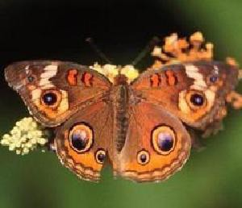
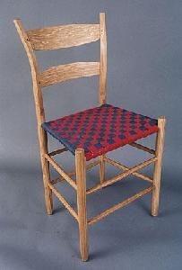












Caltech101 dataset
Fei-Fei et al. (2004)
http://www.vision.caltech.edu/Image_Datasets/Caltech101/Caltech101.html
Multi-class classification results (30 training images per class)
Slide credit: L. Lazebnik

